Slide 1
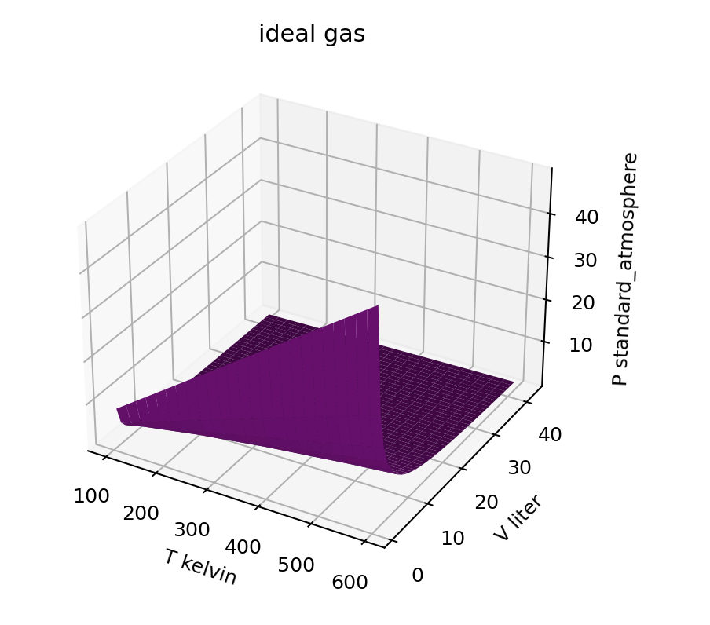
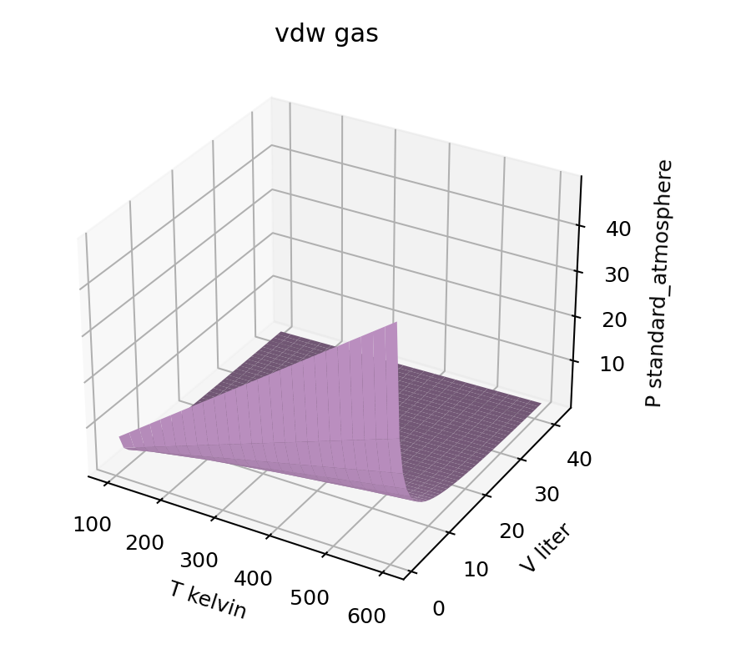
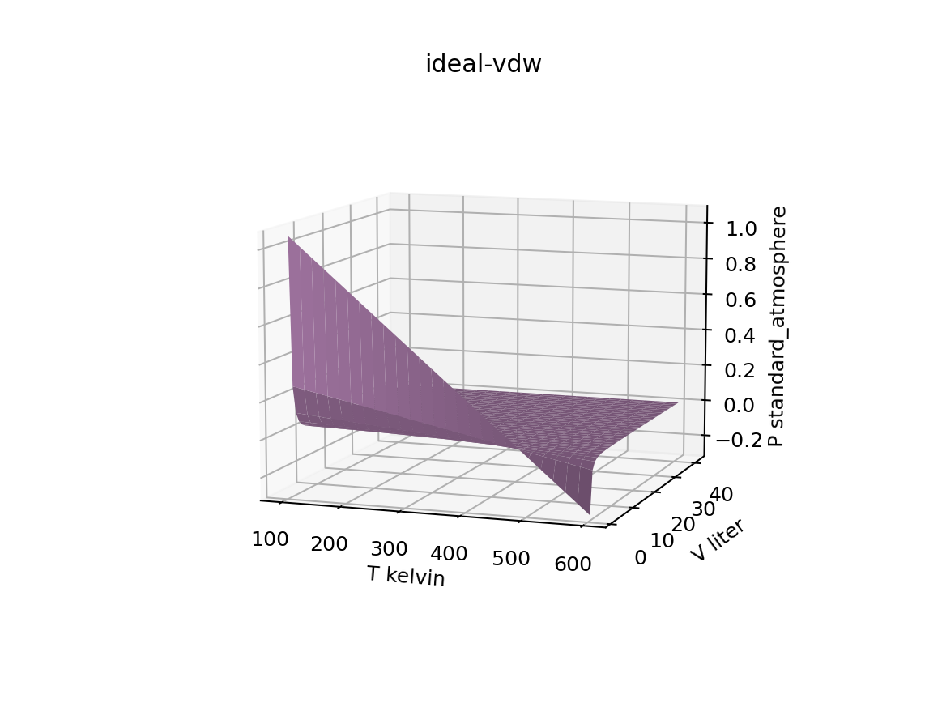


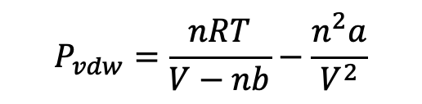
Recap: VisualizingP showed us how to manipulate (add, subtract) entire surfaces
$$P_{ideal}=\frac{nRT}{V}$$
$$P_{vdw}=\frac{nRT}{V−nb}−\frac{n^{2}a}{V^{2}}$$
$P_{ideal}$- $P_{vdw}$
-
=

Slide 2
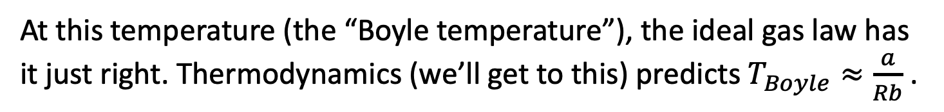

Recap: VisualizingP also showed us how we can use visualizations as an analysis tool
Let’s assume vdw’s equation ($P=\frac{nRT}{V−nb}−\frac{n^{2}a}{V^{2}}$) is more accurate than the ideal gas law (a great assumption). Then differences tell us about deficiencies in assumptions of the ideal gas law.
$P_{ideal}$- $P_{vdw}$
Ideal pressure is too big (real gases have lower pressure)
Ideal pressure is too low (real gases have higher pressure)
At this temperature (the “Boyle temperature”), the ideal gas law has it just right. Thermodynamics (we’ll get to this) predicts $T_{Boyle}≈\frac{a}{Rb}$ .

Slide 3
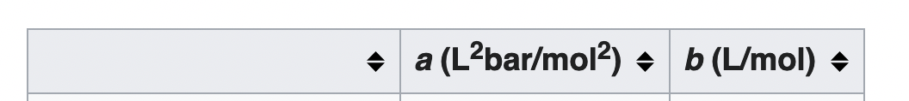
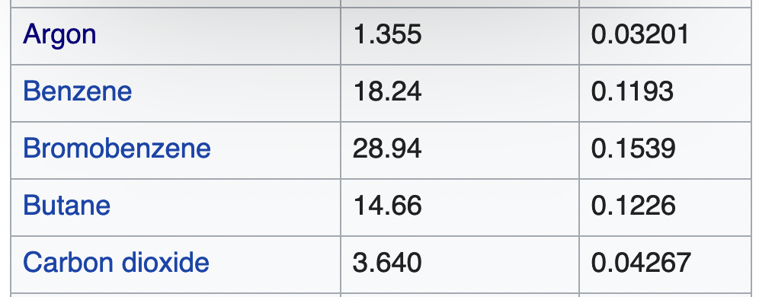
Why is vdw’s law more accurate than the ideal gas law?
Because every gas it has its own adjustable parameters (a and b)

Slide 4
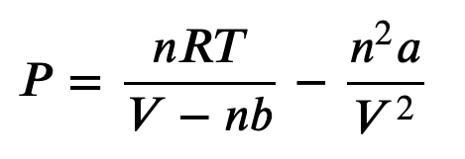
How vdw theory thinks about those parameters
“a” is a measure of intermolecular attraction. If molecules are attracted to one another, they’ll tend to hit the wall less hard and less often, resulting in lower pressure.
“b” is a measure of molecular size. Big molecules will bump into each other more, and therefore hit the wall harder and more often, resulting in higher pressure.
Intermolecular forces

Slide 5
How vdw theory thinks about those parameters
It’s easy to see the molecular size effect here – CO₂ is bigger than Ar, for example, and Bromobenzene is bigger than Benzene.

Slide 6
How vdw theory thinks about those parameters
It’s less easy to understand the intermolecular attraction effect here – why would two CO₂ molecules be more attracted to one another than two Ar atoms? And why does Bromobenzene have such a huge a-value?

Slide 7
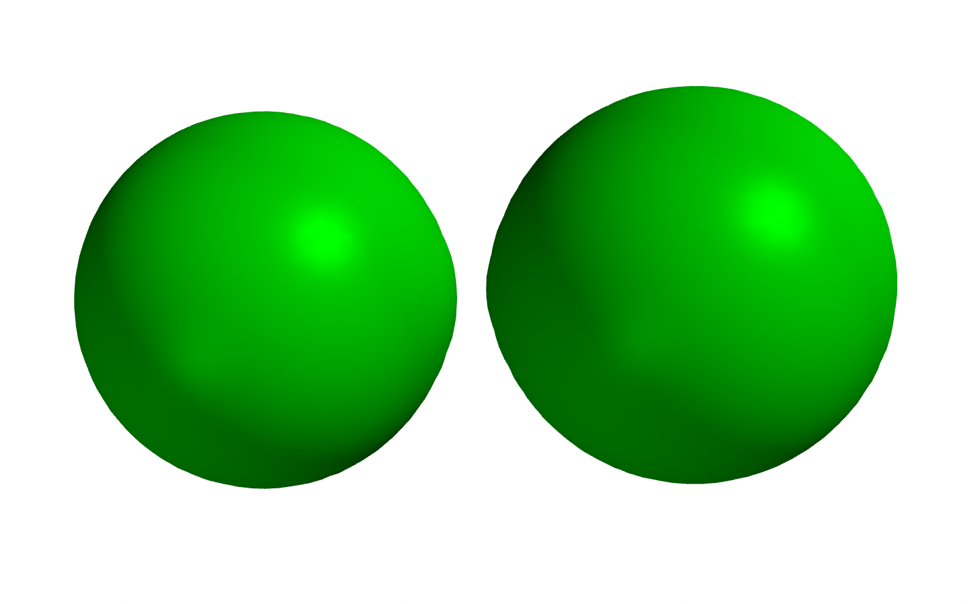
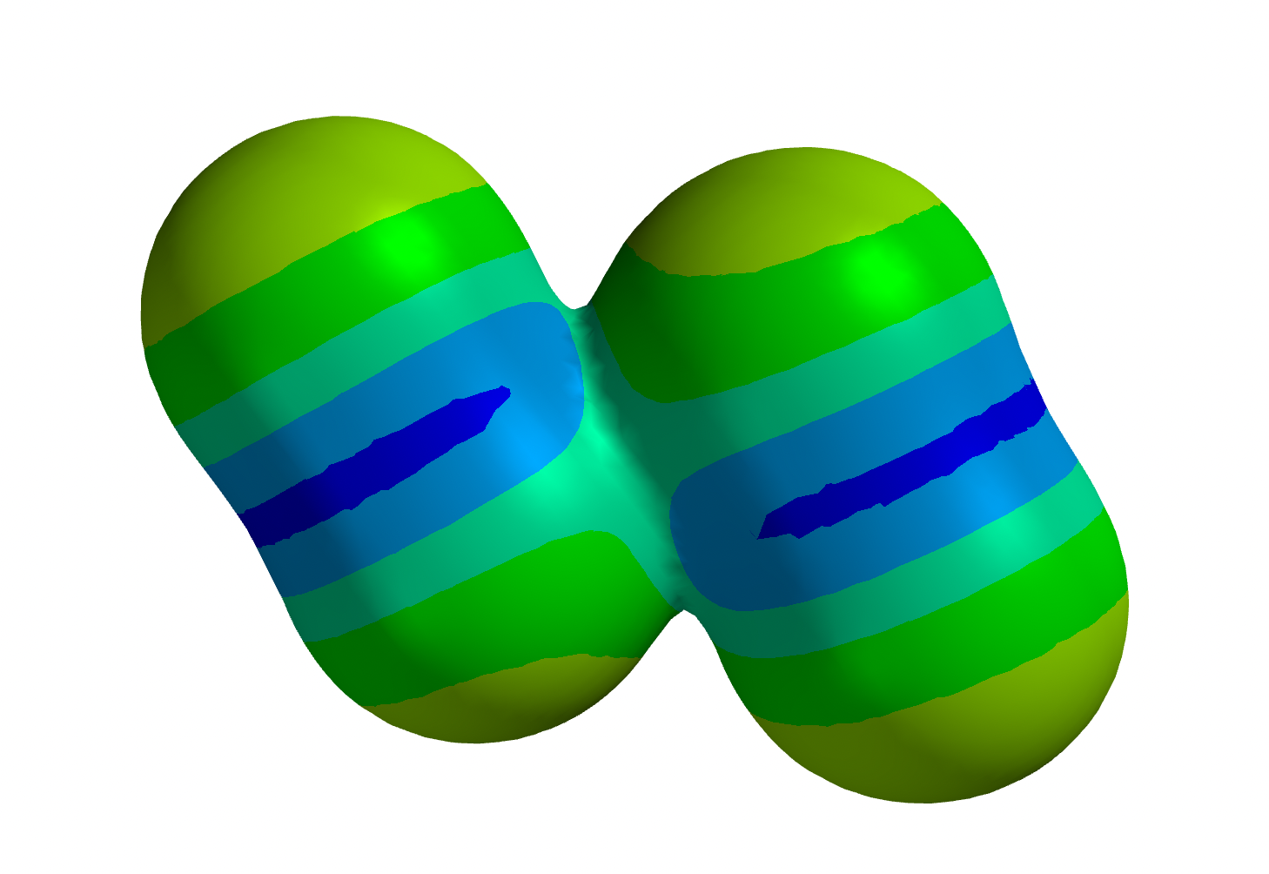
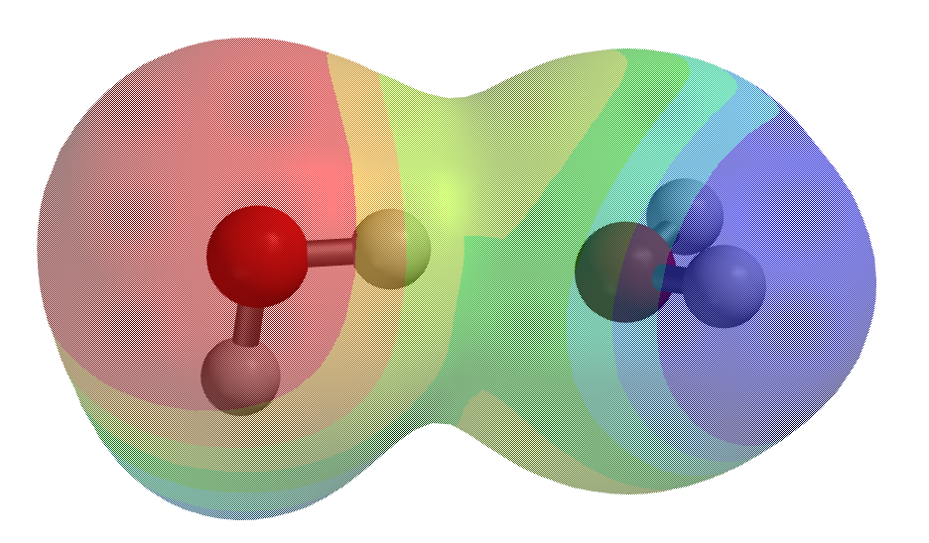
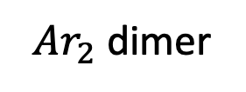
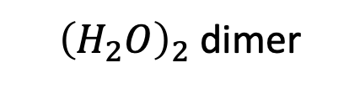
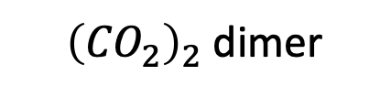
All molecules are slightly “sticky,” but some are more sticky than others
${\left({CO}_{2}\right)}_{2}$ dimer
$Ar_{2}$ dimer
-
+
${\left(H_{2}O\right)}_{2}$ dimer

Slide 8
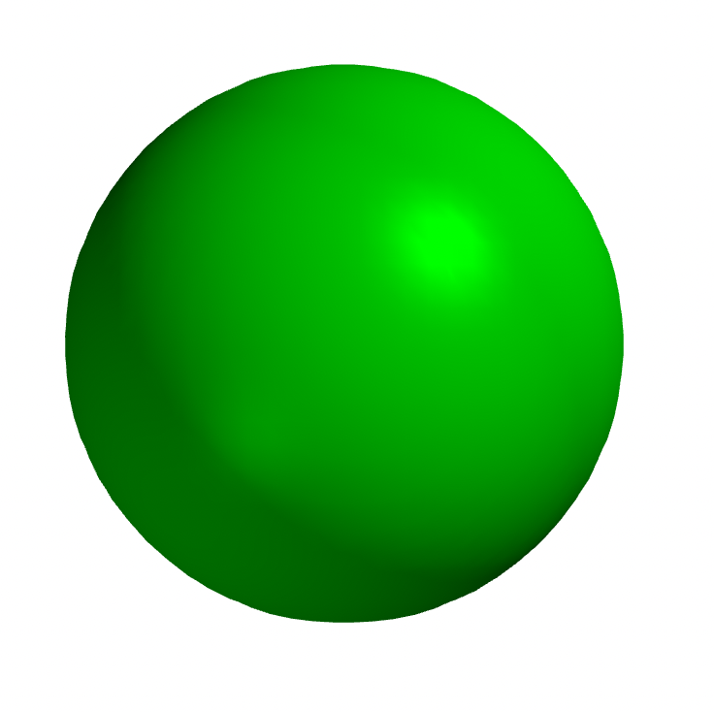
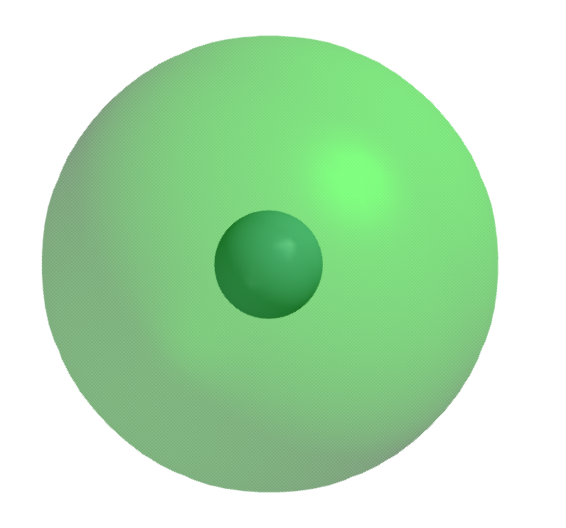


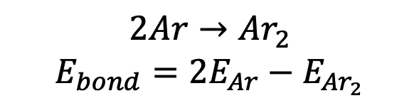
Calculating intermolecular bond strengths from data we get in Spartan
$$Ar$$
$$Ar$$
Solid display
Semi-transparent
$$2Ar→Ar_{2}$$
$$E_{bond}=2E_{Ar}−E_{Ar_{2}}$$

Slide 9
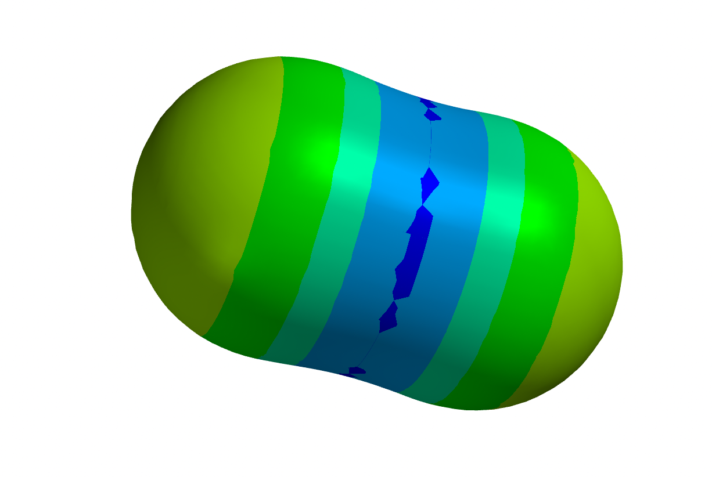
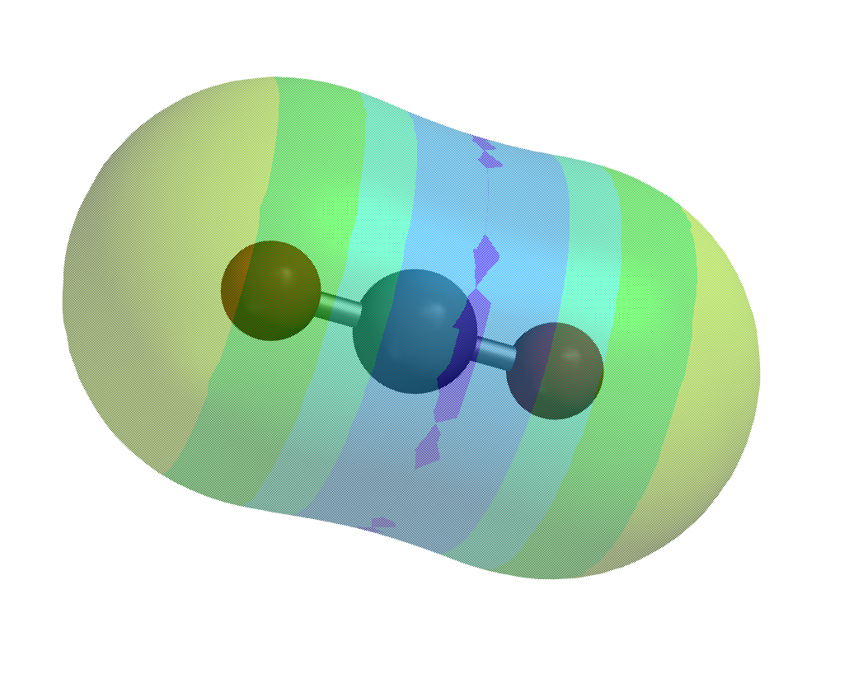
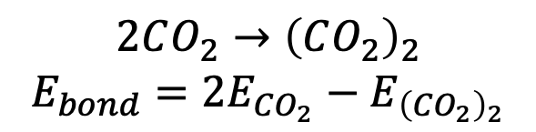
Calculating intermolecular bond strengths from data we get in Spartan
-
+
-
$$2CO_{2}→{\left(CO_{2}\right)}_{2}$$
$$E_{bond}=2E_{CO_{2}}−E_{{\left(CO_{2}\right)}_{2}}$$

Slide 10
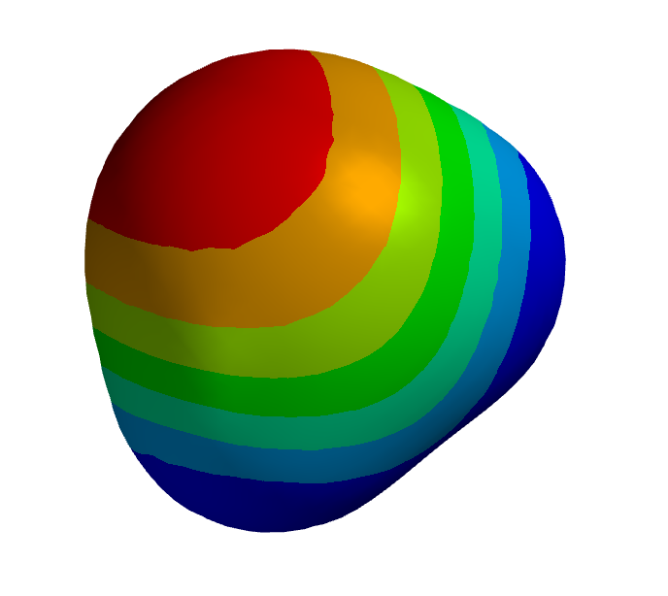
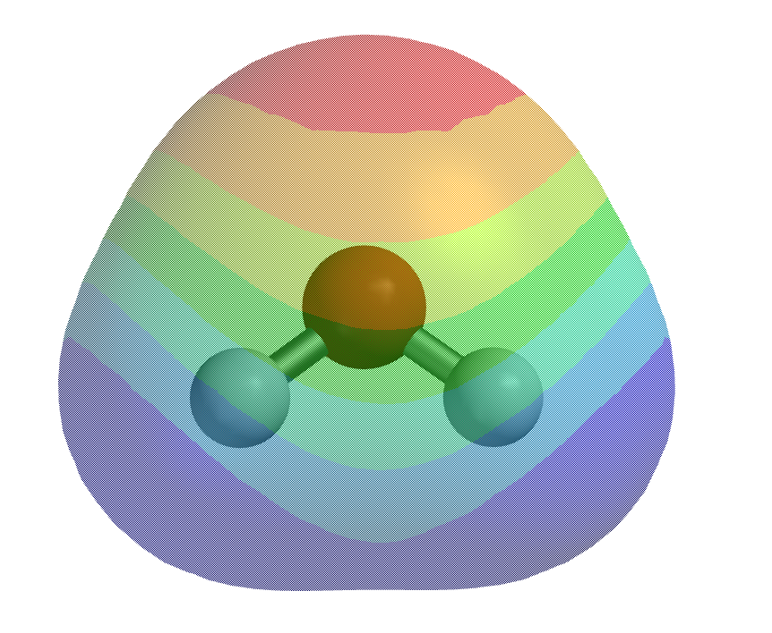
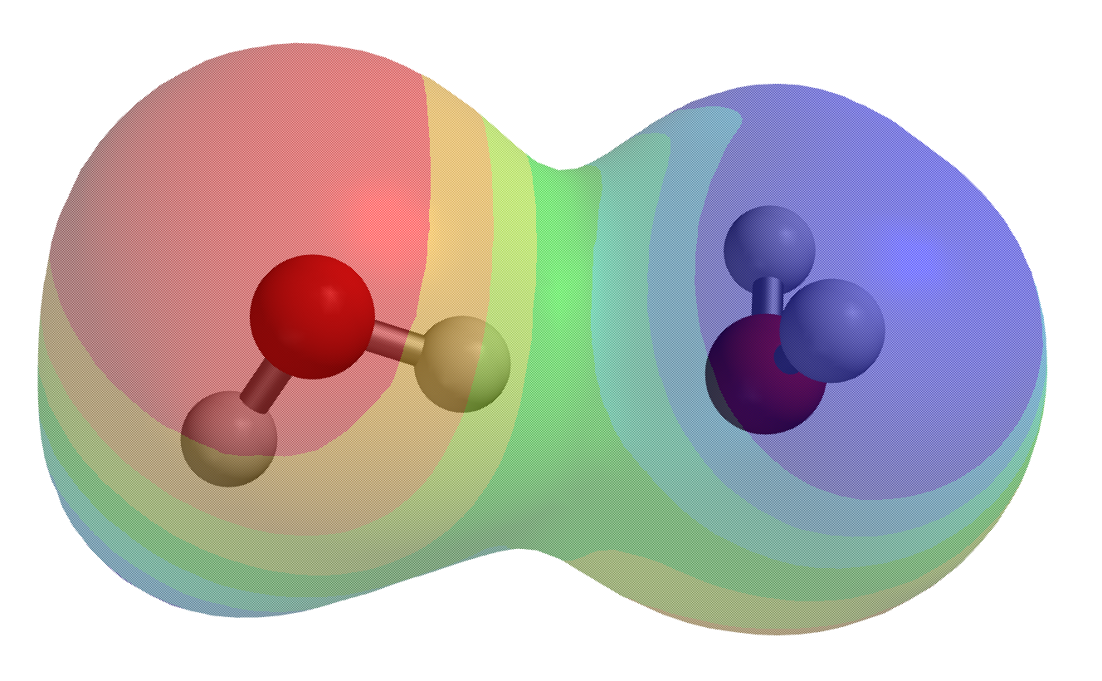
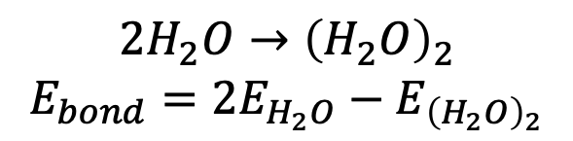
Calculating intermolecular bond strengths from data we get in Spartan
$$2H_{2}O→{\left(H_{2}O\right)}_{2}$$
$$E_{bond}=2E_{H_{2}O}−E_{{\left(H_{2}O\right)}_{2}}$$

Slide 11
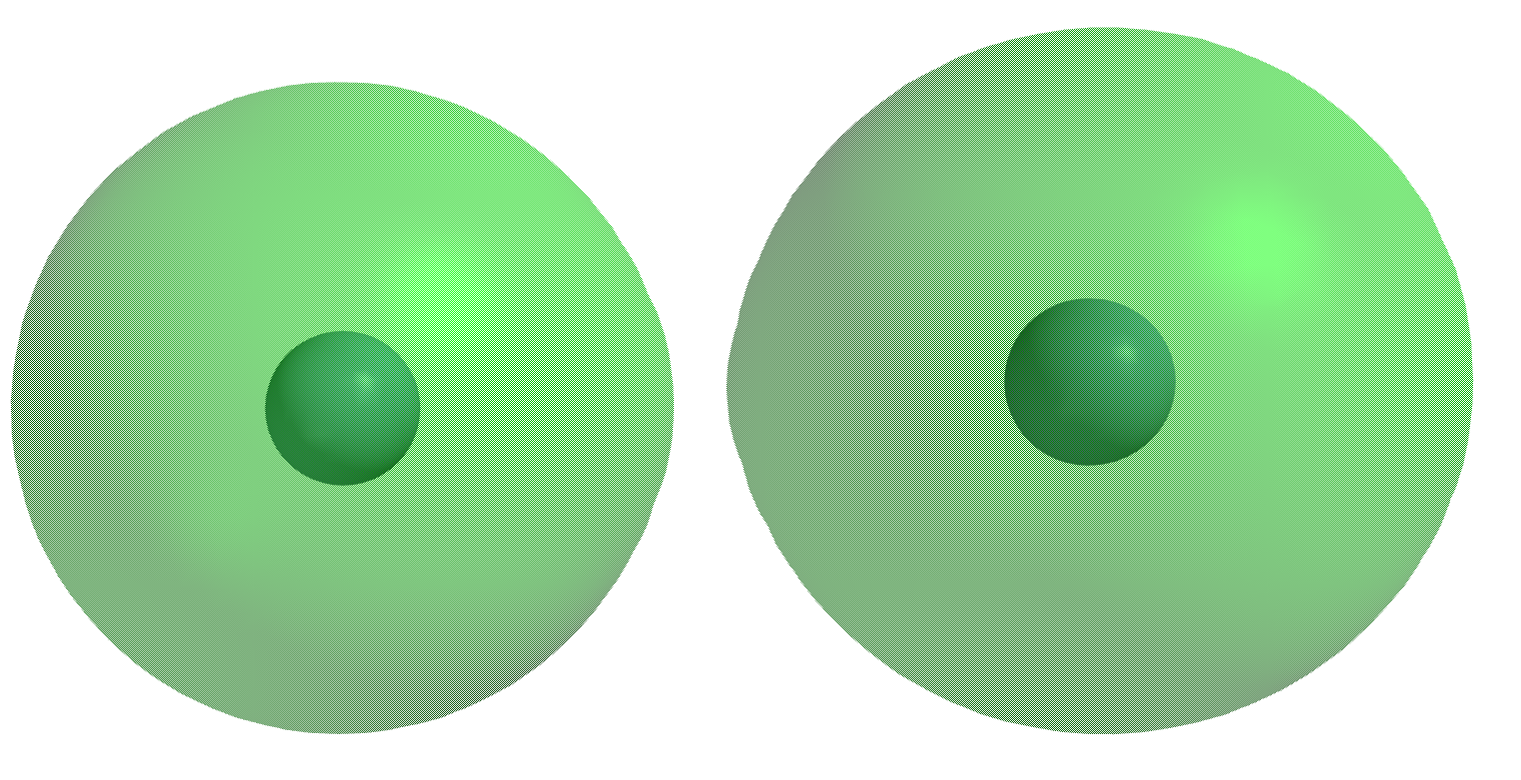
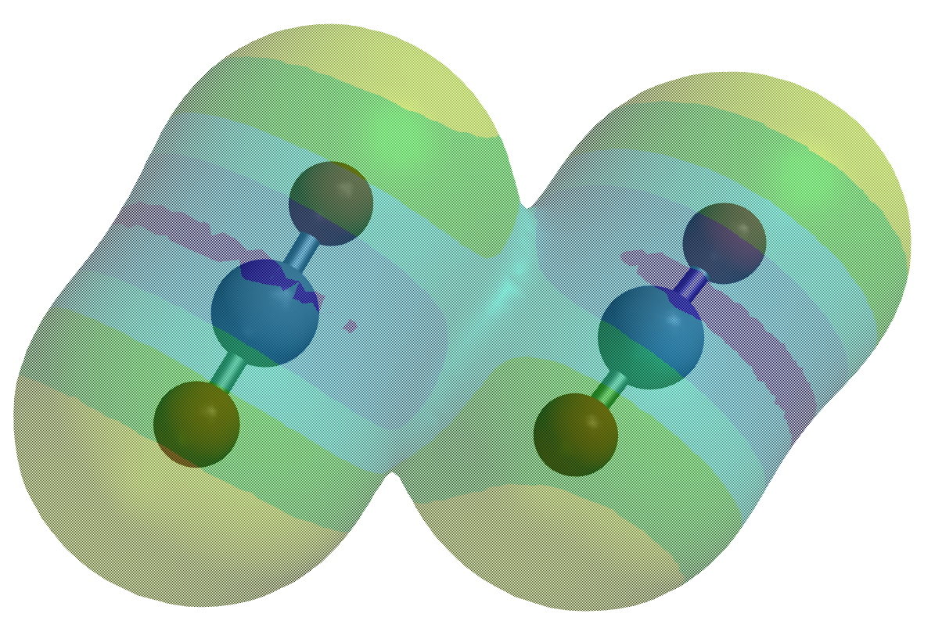
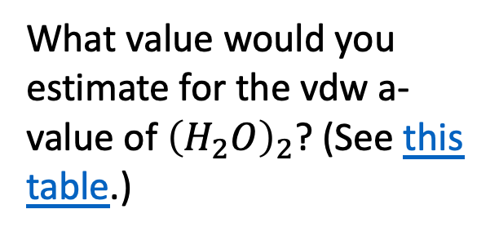
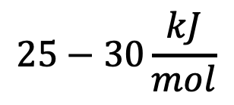
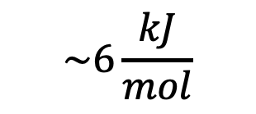
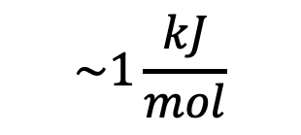
Relating intermolecular bond strengths to vdw “a” value
$$\sim 1\frac{kJ}{mol}$$
$$\sim 6\frac{kJ}{mol}$$
$$25−30\frac{kJ}{mol}$$
What value would you estimate for the vdw a-value of ${\left(H_{2}O\right)}_{2}$? (See this table.)

Slide 12
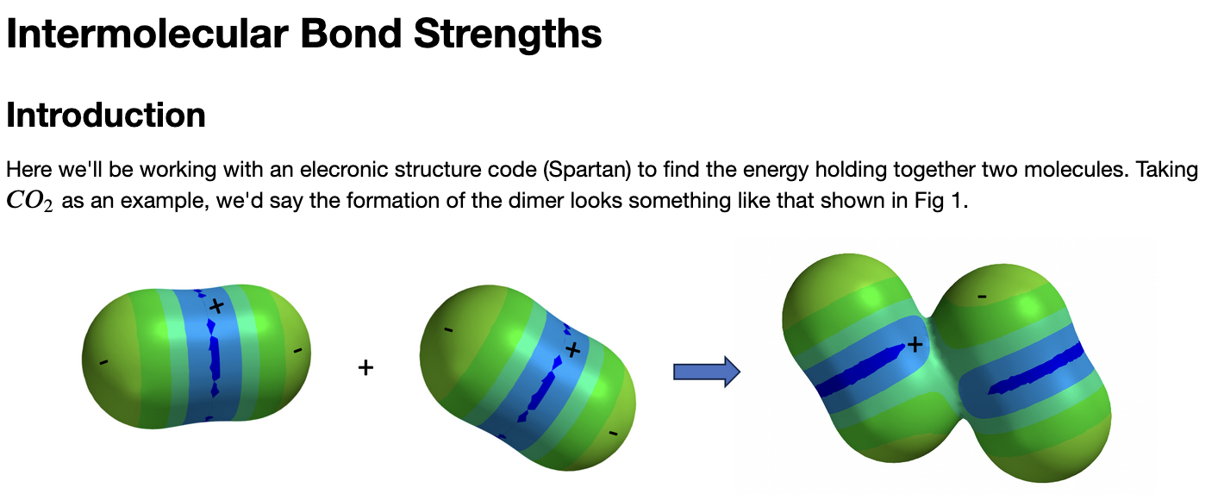
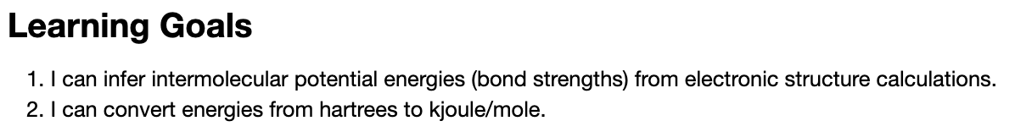
OK, let’s get started

